Slide 1
Machine Learning Premalatha T

Slide 2
WHO AM I?
LinkedIn: https://www.linkedin.com/in/latha-t-k-b21018128/
Data Science ,AIML
Data Analysis ,SQL,Pyspark
Data Visualization ,PowerBI,Tableau
Natural Language Processing (NLP)
Computer Vision
Generative AI,Prompt Engineering
BigData and Data Engineering

Slide 3
Agenda
What is ML,AI and DS
Data and how its helpful in decision making
Real-world applications
Types of analytics
Steps in a ML Project

Slide 4
What is Data?

Slide 5
Data
In today's data-driven world, information is king. But raw data itself isn't enough.
We need to analyze it to extract insights and make informed decisions

Slide 6
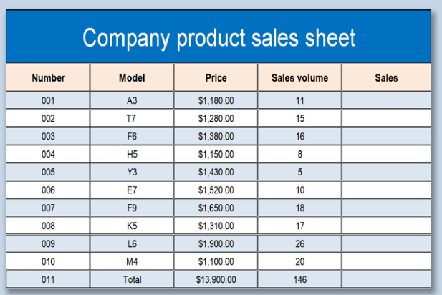
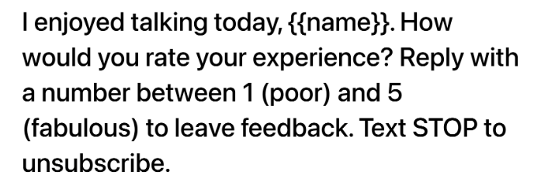

Slide 7
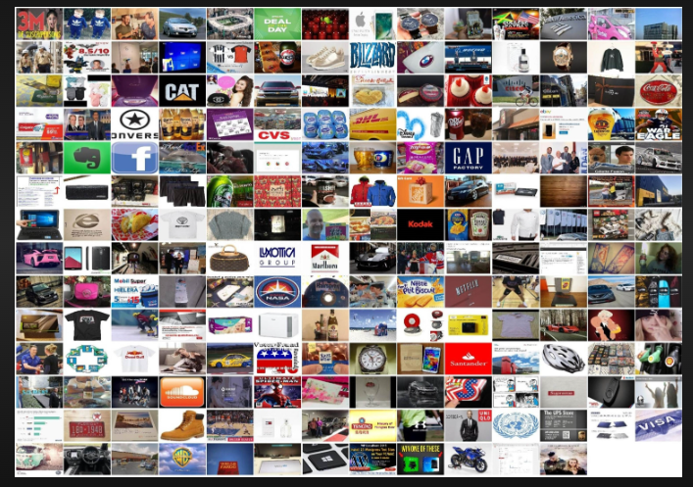
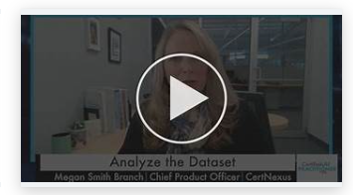
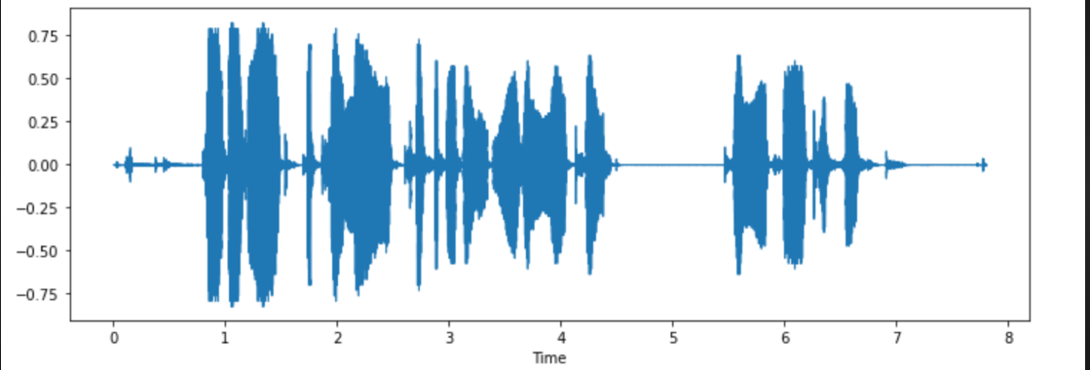

Slide 8






Slide 9
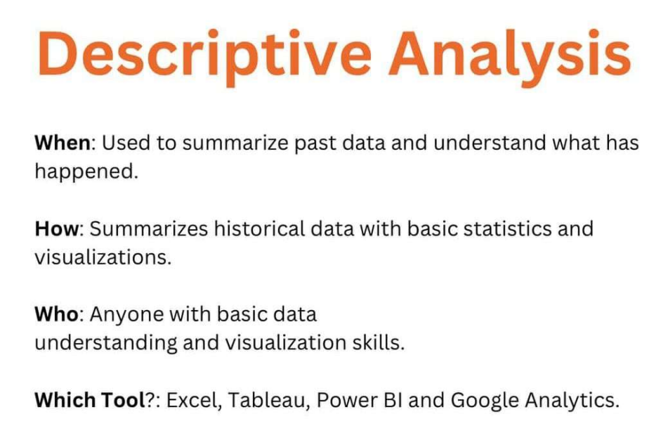

Slide 10
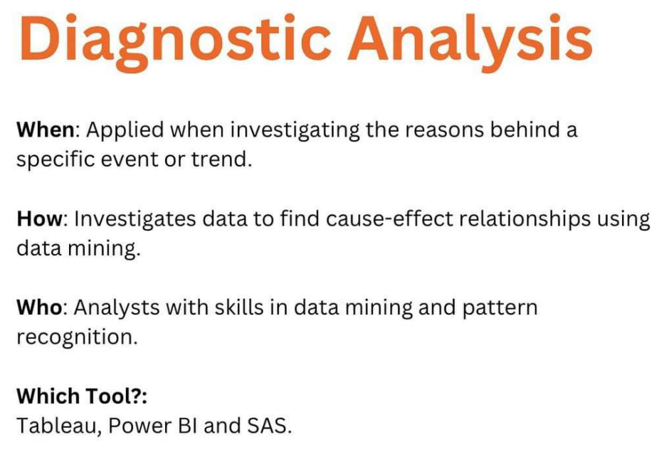

Slide 11
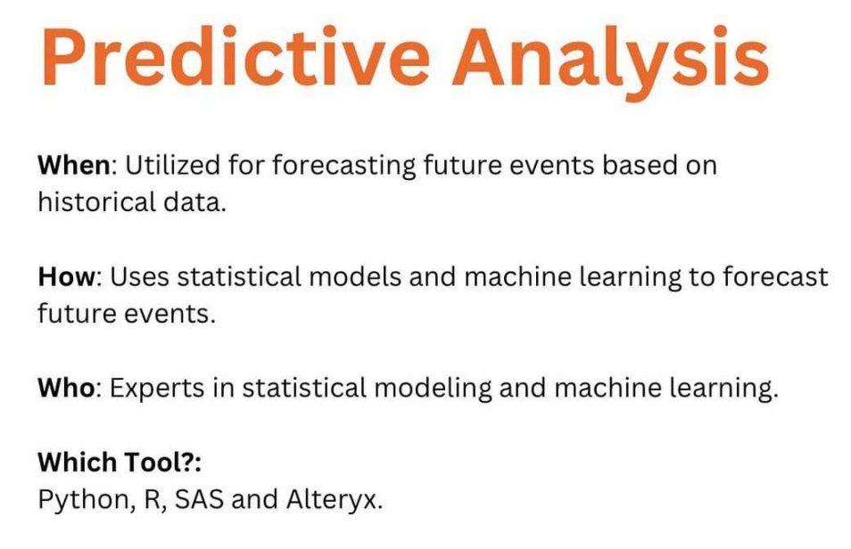

Slide 12
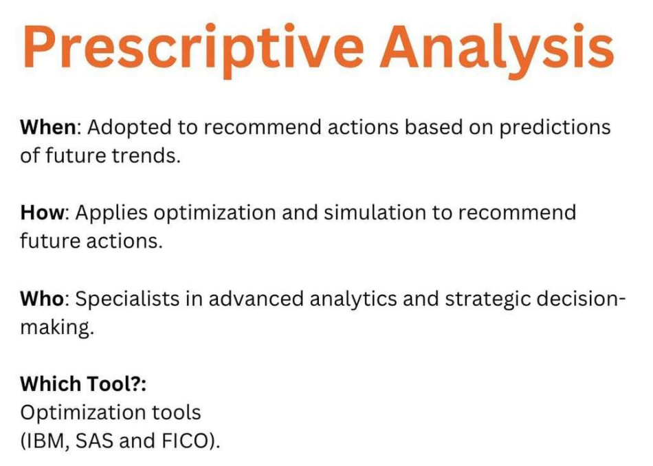

Slide 13
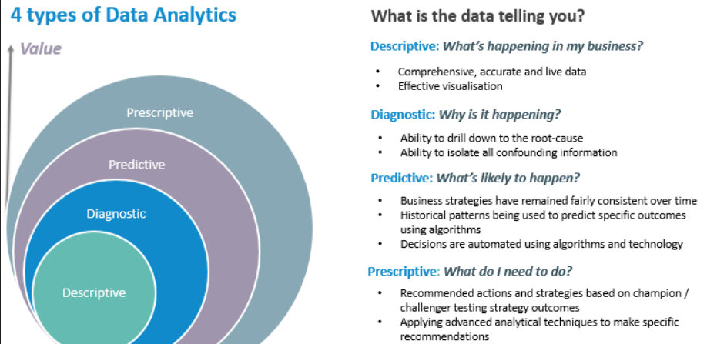

Slide 14
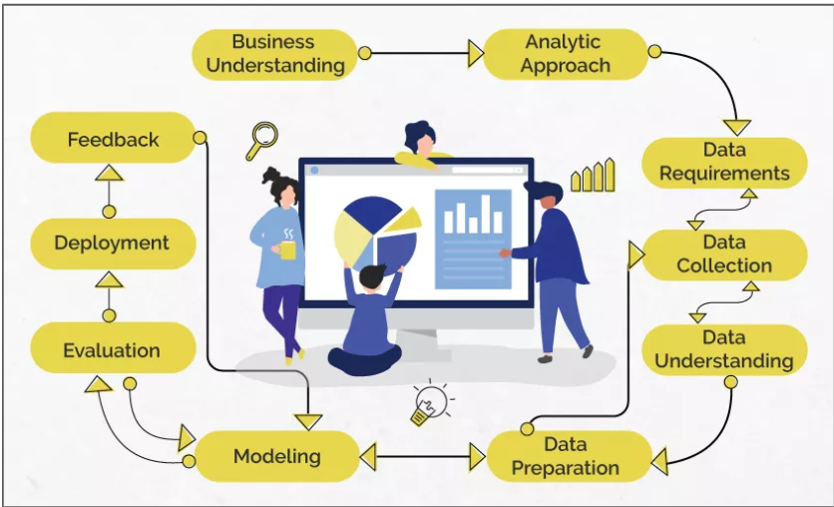
Data Science/Machine Learning

Slide 15
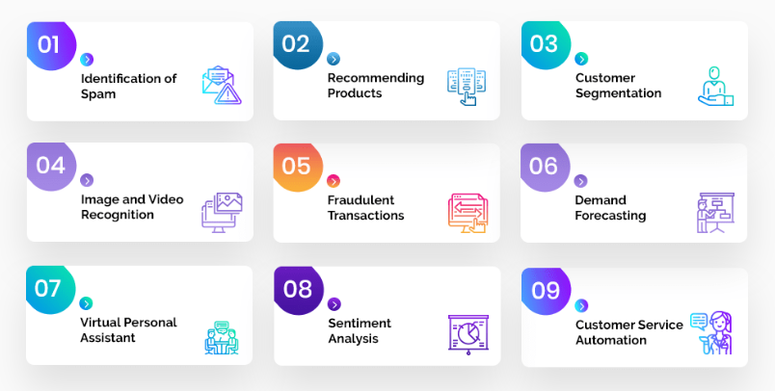
Problem Statement

Slide 16
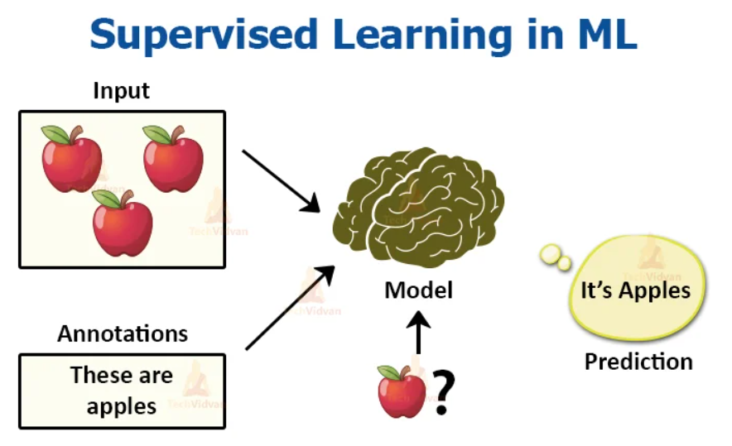
Analytic Approach

Slide 17
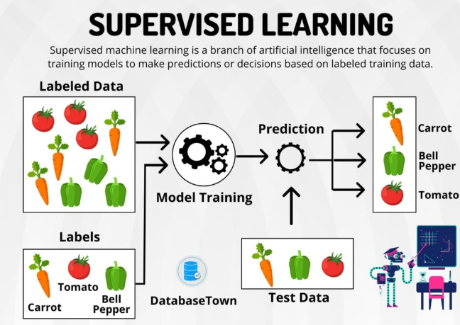

Slide 18
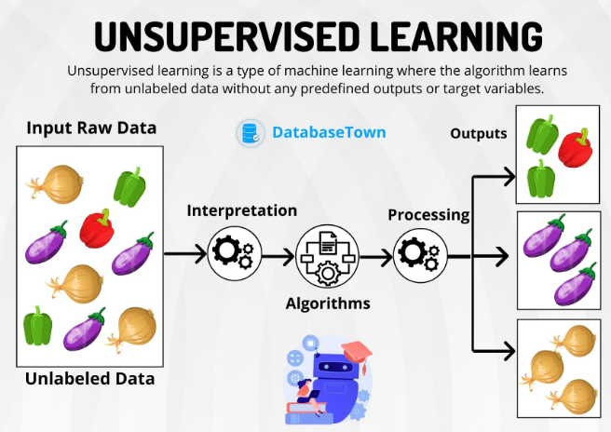

Slide 19
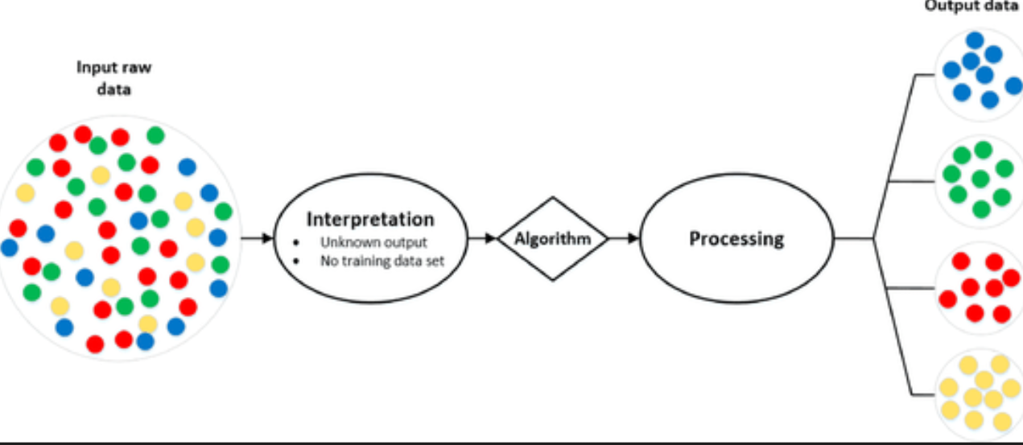
Analytic Approach

Slide 20
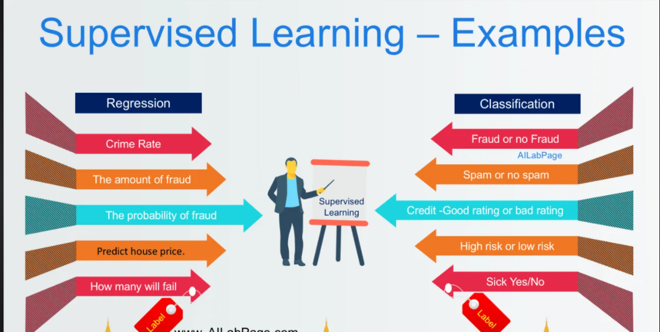
Supervised Learning

Slide 21
Machine Learning
Supervised Learning
Unsupervised Learning

Slide 22
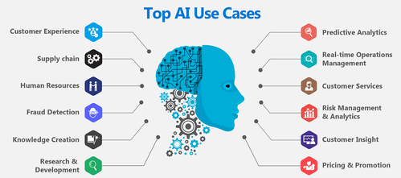

Slide 23
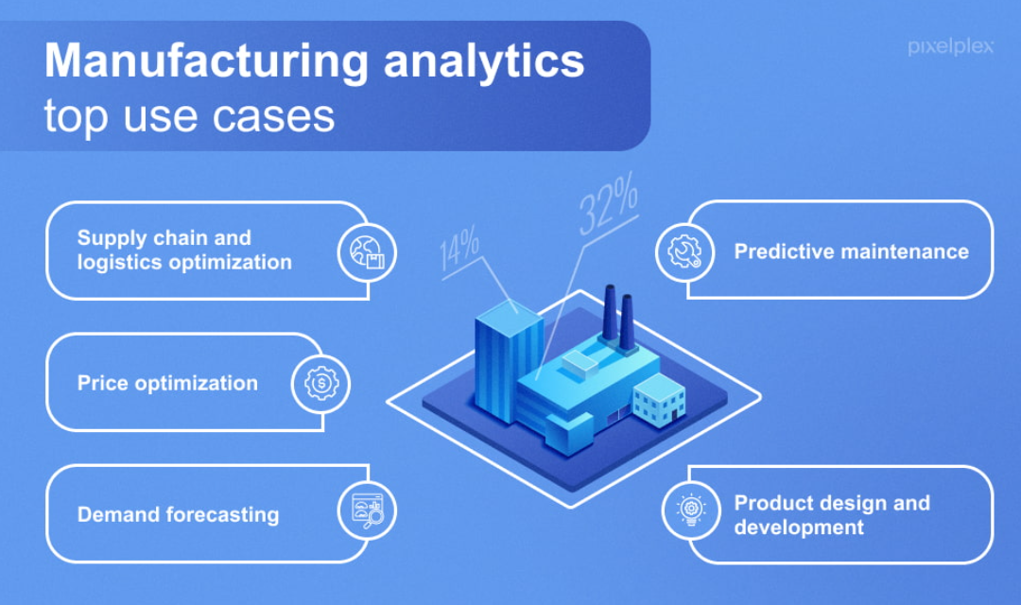

Slide 24
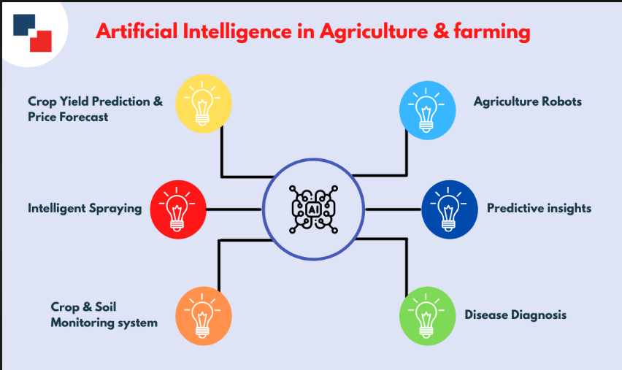

Slide 25



Anaconda Introduction
Anaconda Intro
Anaconda Installation
Overview of Anaconda Packages
Installation of Jupyter Notebook
Conda Libraries

Slide 26
Anaconda Intro
Anaconda is a free and open-source distribution of the Python and R programming languages for scientific computing (data science, machine learning applications, large-scale data processing, predictive analytics, etc.), that aims to simplify package management and deployment. The distribution includes data-science packages suitable for Windows, Linux, and macOS. It is developed and maintained by Anaconda, Inc., which was founded by Peter Wang and Travis Oliphant in 2012. As an Anaconda, Inc. product, it is also known as Anaconda Distribution or Anaconda Individual Edition, while other products from the company are Anaconda Team Edition and Anaconda Enterprise Edition, which are both not free.

Slide 27
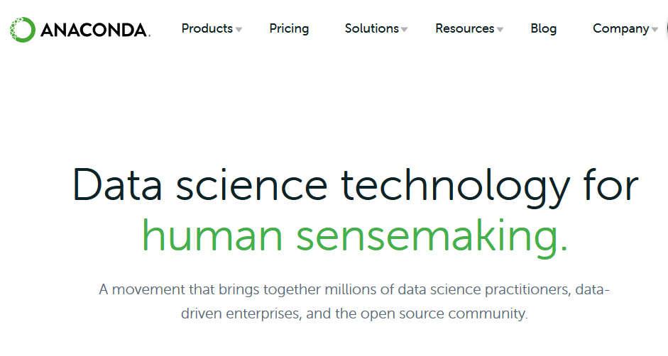
Anaconda Installation
Visit the url for the software download https://www.anaconda.com/products/individual
Click on it
Follow the instructions
Software Version : Anaconda 3

Slide 28
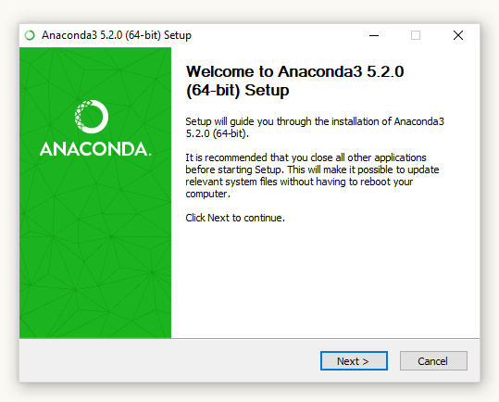
Anaconda Installation

Slide 29
Overview of Anaconda Packages

Slide 30
Installation of Jupyter Notebook
pip
If you use pip, you can install it with:
pip notebook
To run the notebook, run the following command at the Terminal (Mac/Linux) or Command Prompt (Windows):
jupyter notebook

Slide 31
Questions ????

